Slide 1

Introduction to Security: Operations & Management
5th Edition
Chapter 10
Management, Leadership, & Ethics in Security

Slide 2
Learning Objectives (1 of 2)
After completing this chapter, the reader should be able to:
1. Explain some of the key difference between private and public administration
2. Explain some of the key characteristics of a bureaucracy
3. Explain what management means
4. Explain some of the key responsibilities of managers
5. Explain how the concept and practice of management has evolved in organizations
Notes:
Slide 2 is list of textbook LO numbers and statements

Slide 3
Learning Objectives (2 of 2)
6. Understand what effective supervision is and why it is important
7. Know the difference between management and supervision
8. Explain and apply the concept of leadership in organizations
9. Understand some of the behavioral assumptions of leadership styles
10. Know how to ensure ethics and integrity in organizations through ethical leadership
Notes:
Slide 2 is list of textbook LO numbers and statements

Slide 4
Introduction to Management & Leadership
Early origins:
Key points:

Slide 5
The Need for Effective Administration
Definitions of Administration:
Max Weber’s Theory of Bureaucracy
  Background
  6 Points
  The Post-Bureaucratic Organization

Slide 6
What is Management? (1 of 4)
Introduction/Definitions:
Core Functions of Management – POSDCORB:

Slide 7
What is Management? (2 of 4)
Mintzberg – 10 managerial roles:
Managerial levels:

Slide 8
The Evolution of Managerial Thought (3 of 4)
Classical Management:
Human Relations Movement:

Slide 9
The Role of Supervision in the Workplace
(3 of 4)
Supervision defined:
Key points of supervision:

Slide 10
Leadership (1 of 6)
Introduction/Definitions:
Compared to supervision & management:

Slide 11
Leadership (2 of 6)
Leadership Theories:
  Transactional
  Transformational

Slide 12
Leadership (3 of 6)
Leadership Theories (continued):
  4 Competencies of Leadership
  Daniel’s 13 Leadership Competencies
  Kotter
  Drath & Palus

Slide 13
Leadership (4 of 6)
Behavioral Assumptions & Leadership Style:
  Theory X
  Theory Y
  Theory Z

Slide 14
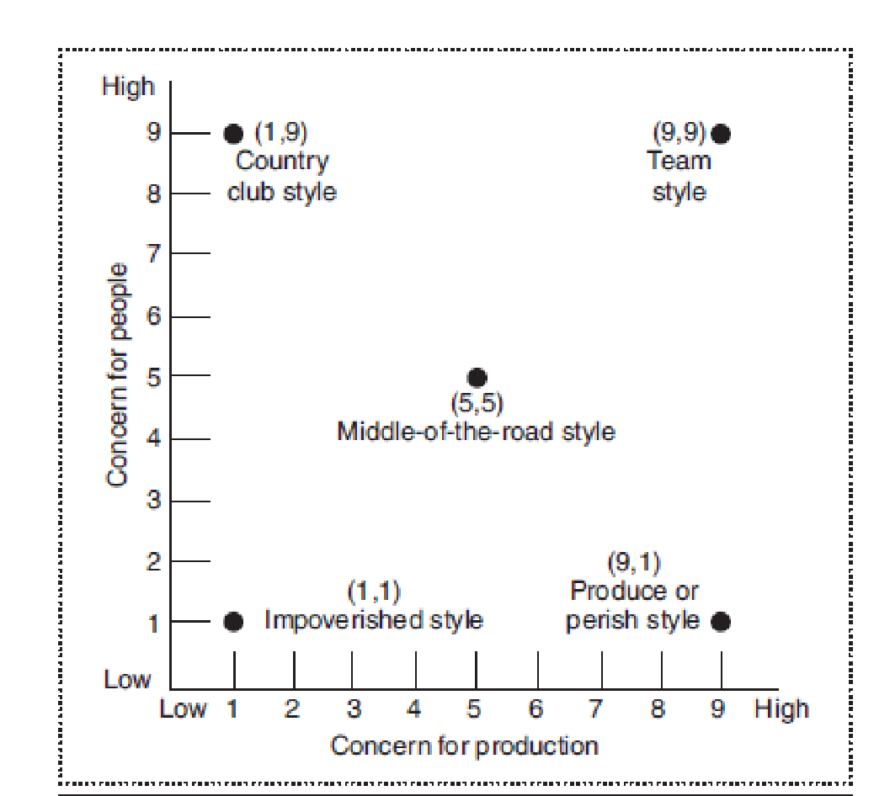
Leadership (5 of 6)
Managerial Grid

Slide 15
Leadership (6 of 6)
Situational Leadership Model:
Path-Goal Leadership:

Slide 16
Ensuring Ethics and Integrity (1 of 3)
Introduction/Definitions:
Four fundamental ethical principles:

Slide 17
Ensuring Ethics and Integrity (2 of 3)
4 standards in applying ethics:
Ethical dilemmas:

Slide 18
Ensuring Ethics and Integrity (3 of 3)
Unethical activities:
Ethical standards:
Ethical leadership:
ASIS Code of Ethics:

Slide 19
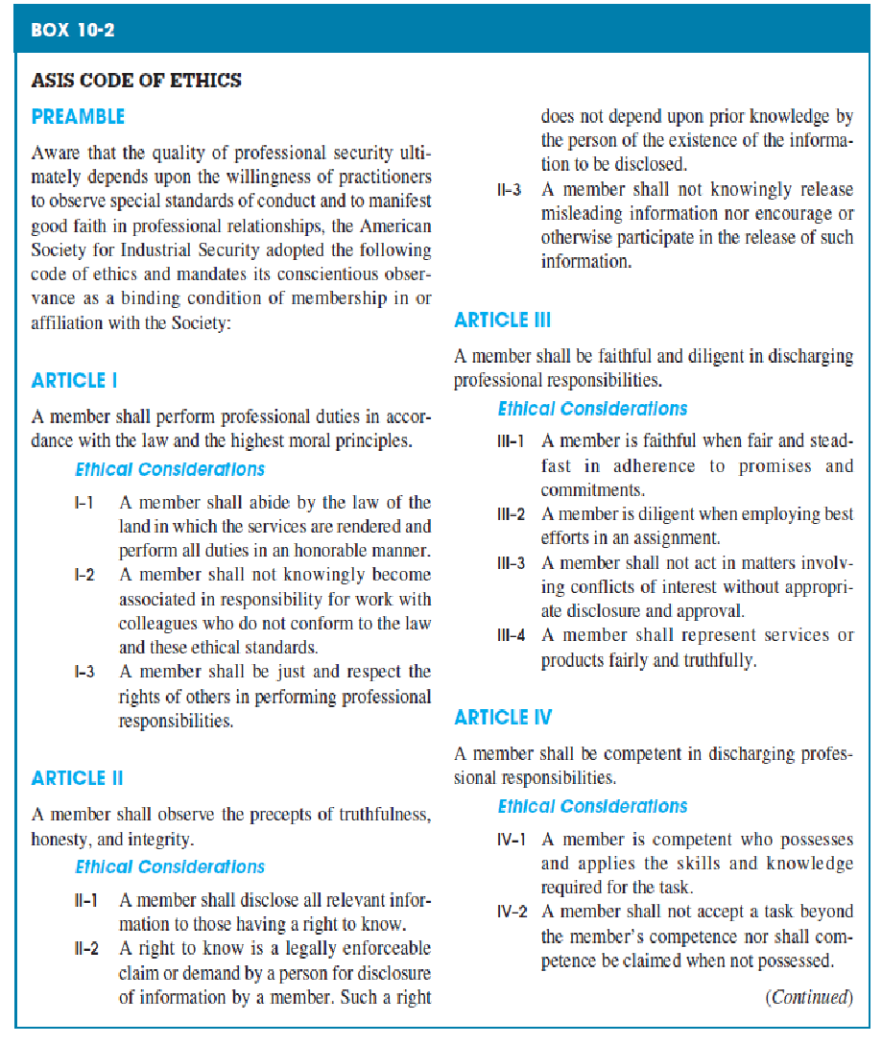
ASIS Code of Ethics

